Slide 1
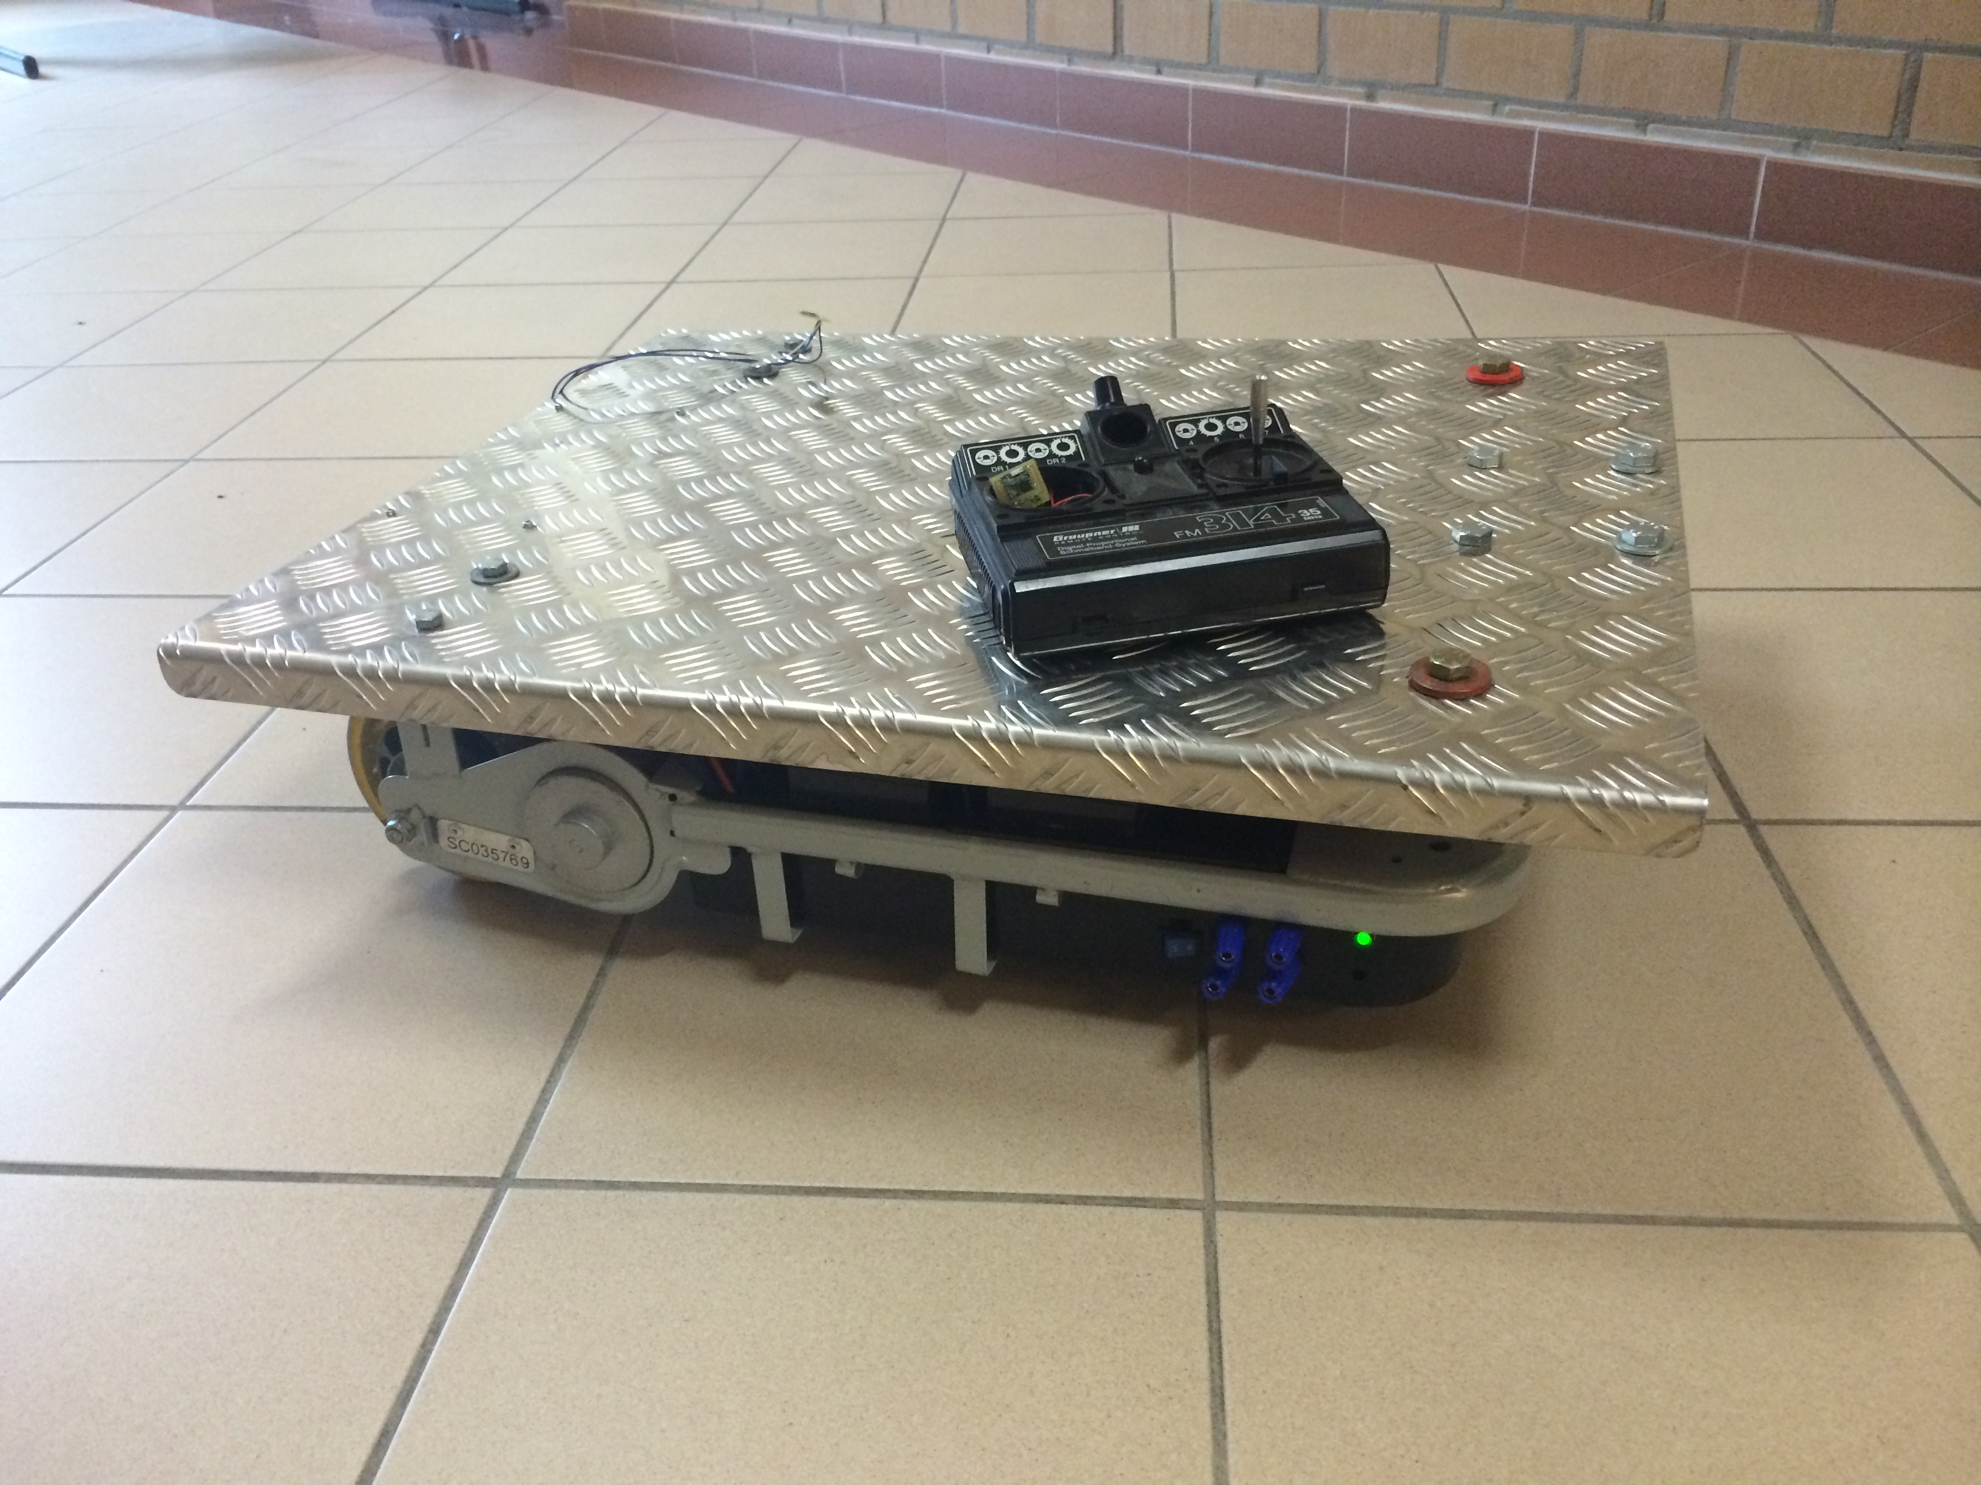
Robotplatform
Tom Nieskens
Matthias Jooris

Slide 2
inleiding
-analyse project
-bekabeling
-verfijnen software
-nieuwe afstandsbediening
-draadloos
-applicatie

Slide 3
bekabeling
voor: na:

Slide 4
bekabeling

Slide 5
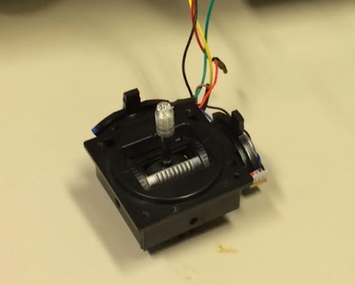
afstandsbediening

Slide 6
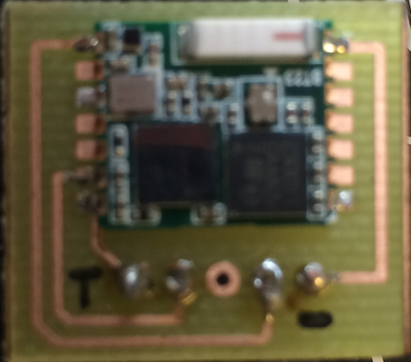
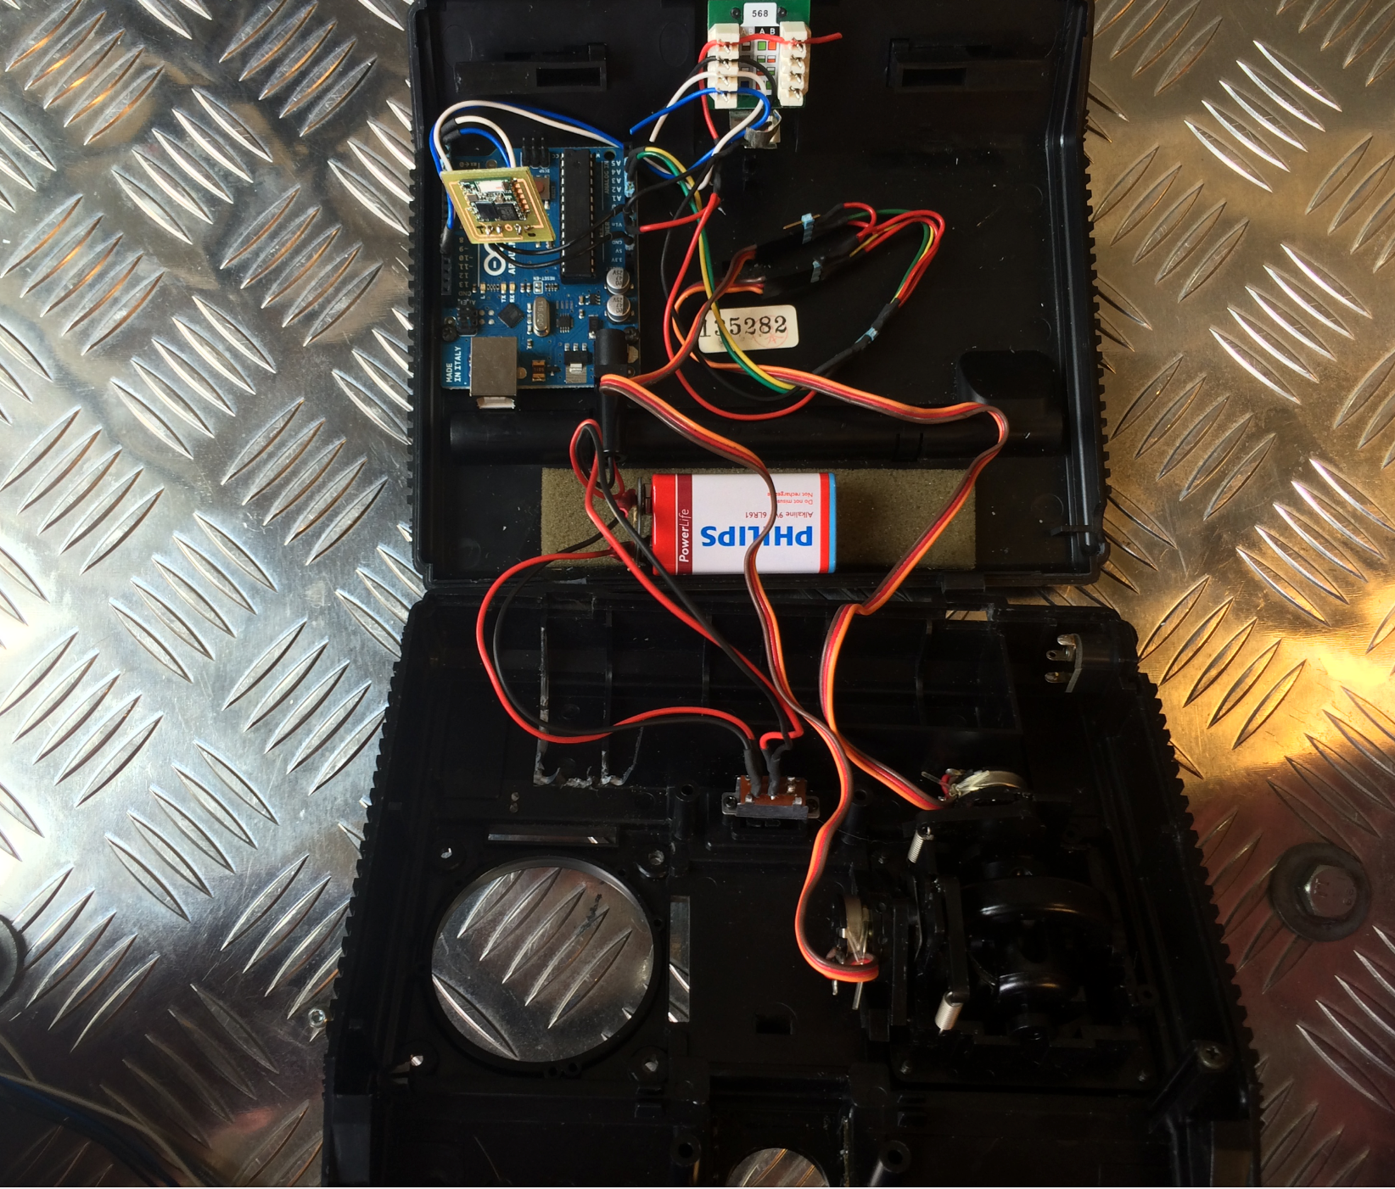
Bluetooth

Slide 7
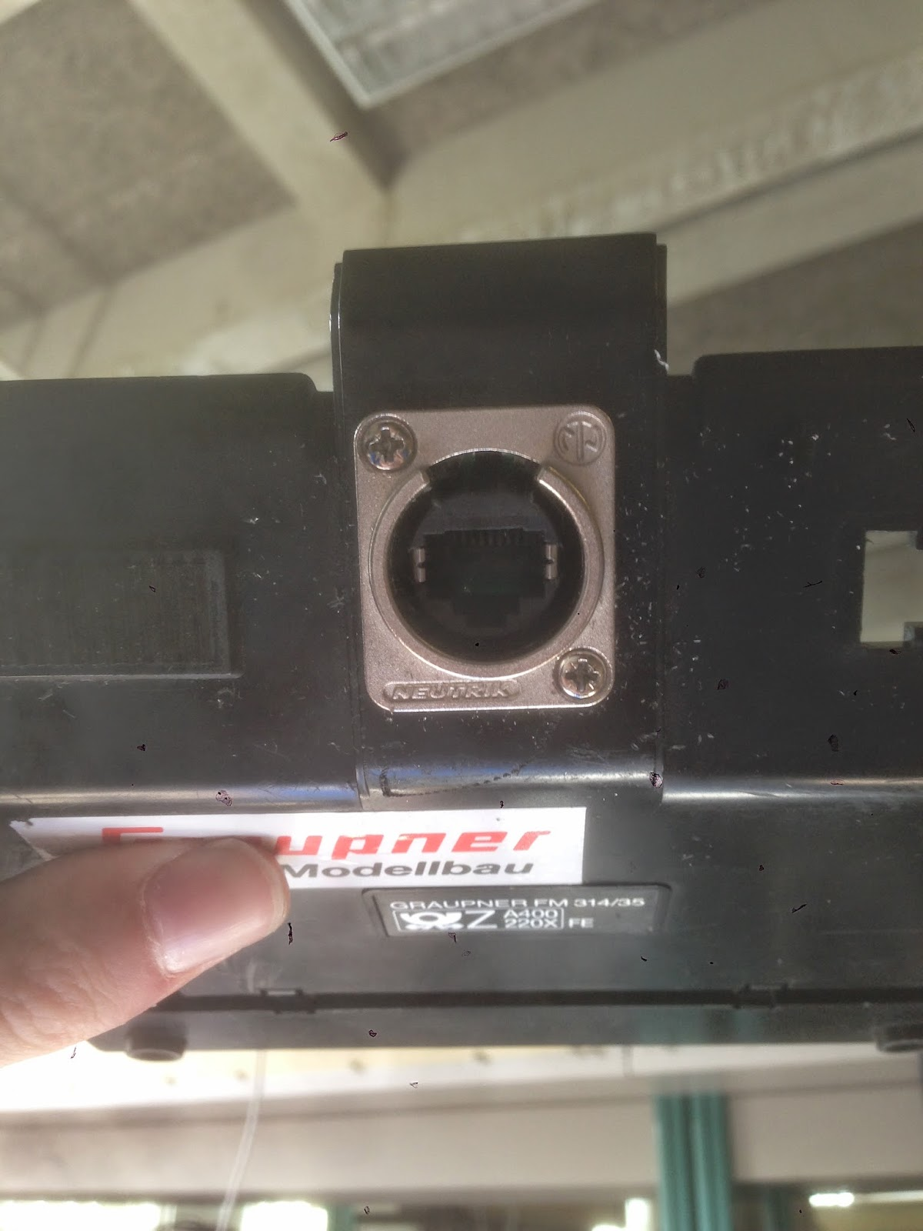
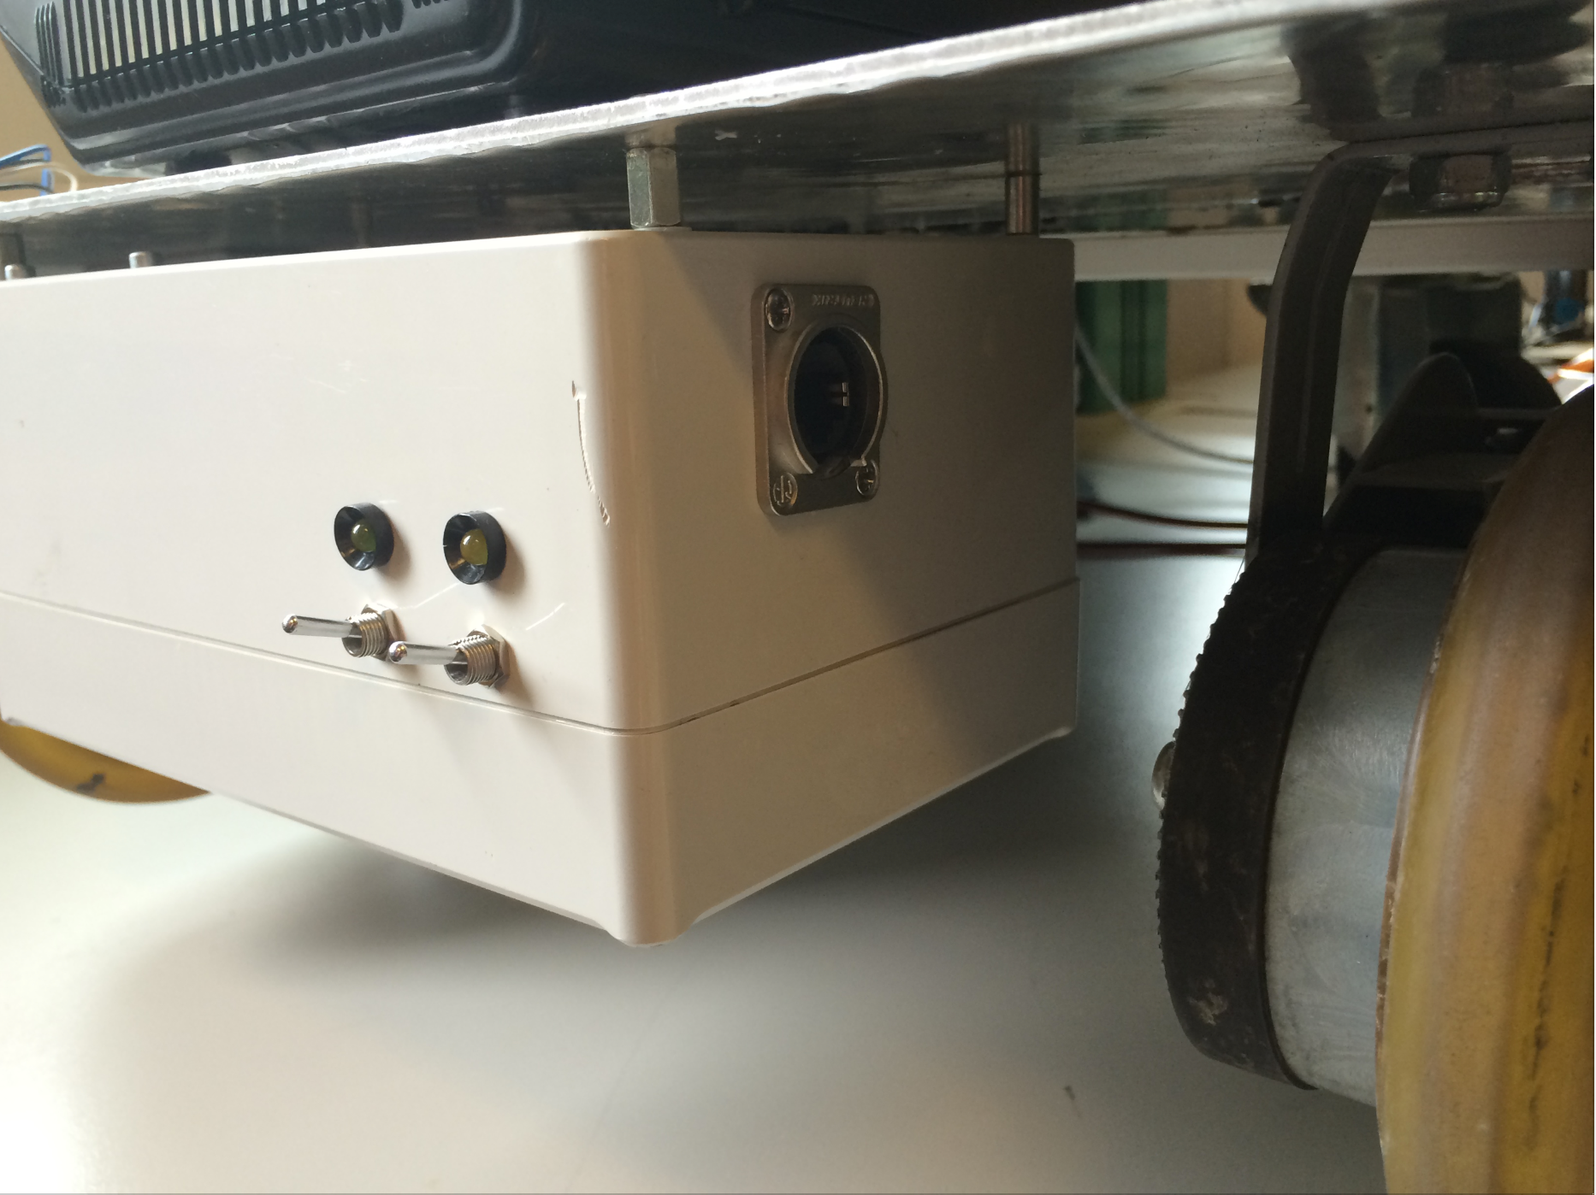
bekabelde verbinding

Slide 8
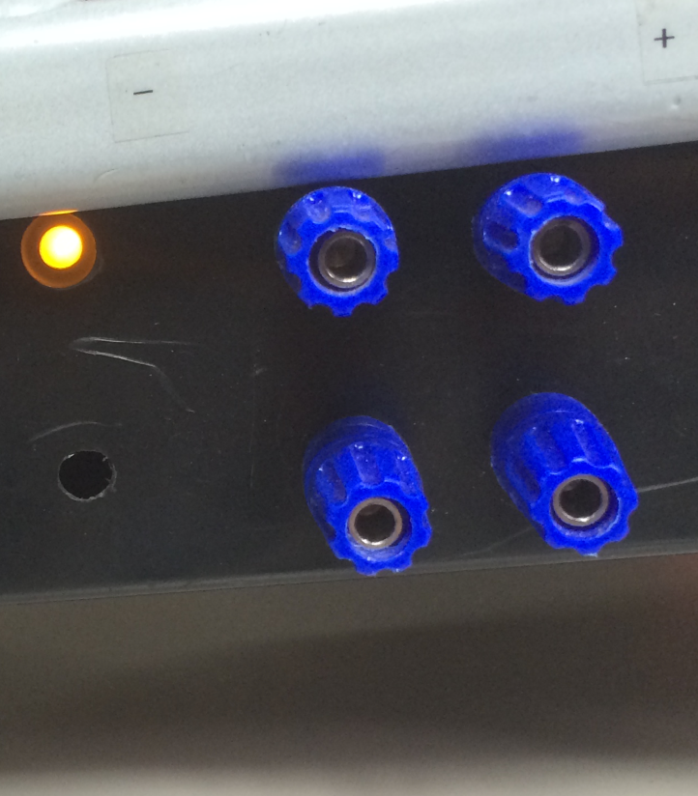
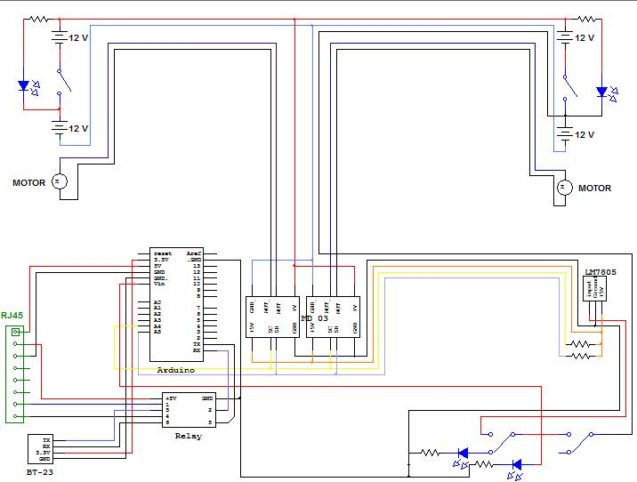
schema platform

Slide 9
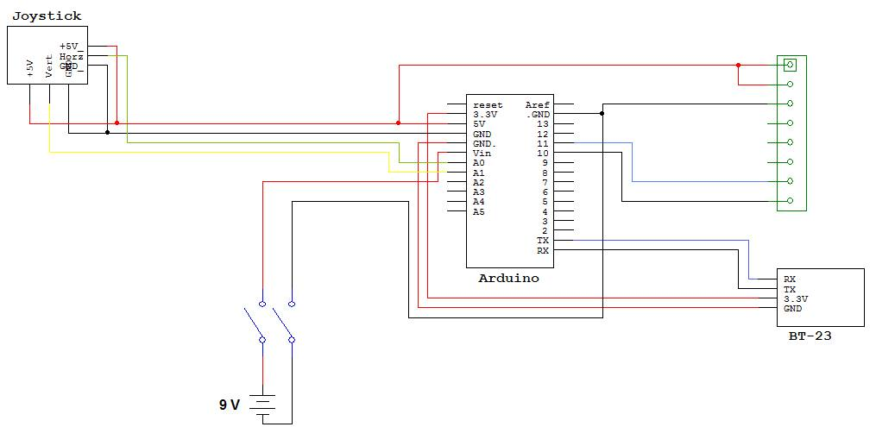
schema afstandsbediening

Slide 10
code platform
recievedChar =Serial.parseInt();
if (recievedChar > 0)
{
if(recievedChar==1066){// if it sees 1066 then it knows that valueFB is comming
valueFB = Serial.parseInt(); //Reads integers as integer rather than ASCI. Anything else returns 0
Serial.println(valueFB);// prints valueFB so I could see it int the serial monitor
}
if(recievedChar==1065){// if it sees 1066 then it knows that valueLR is comming
valueLR = Serial.parseInt(); //Reads integers as integer rather than ASCI. Anything else returns 0
Serial.println(valueLR);// prints valueLR so I could see it int the serial monitor
}
}else{
valueLR = 500;
valueFB = 500;
}

Slide 11
code platform
if(valueFB>510){ //forwards
if(valueLR>505){ //forwards+left
speed1 =((valueFB-400)/2);
speed2 =((valueFB-400)/2)-((valueLR-450)/2) ; // left motor slows down
}
else if(valueLR<495){ //forwards+right
speed1 = ((valueFB-400)/2)-((550-valueLR)/2); // right motor slows down
speed2 =((valueFB-400)/2) ;
}
else{ //forwards
speed1 = ((valueFB-400)/2);
speed2 = ((valueFB-400)/2);
}

Slide 12
code platform
Wire.beginTransmission(MD03_1);
Wire.write(SPEED_reg);
Wire.write(speed1);
Wire.endTransmission();
Wire.beginTransmission(MD03_2);
Wire.write(SPEED_reg);
Wire.write(speed2);
Wire.endTransmission();
Wire.beginTransmission(MD03_1);
Wire.write(ACC_reg);
Wire.write(27);
Wire.endTransmission();
Wire.beginTransmission(MD03_2);
Wire.write(ACC_reg);
Wire.write(27);
Wire.endTransmission();
Wire.beginTransmission(MD03_1);
Wire.write(CMD_reg);
Wire.write(1); // sets motor forward
Wire.endTransmission();
Wire.beginTransmission(MD03_2);
Wire.write(CMD_reg);
Wire.write(1); // sets motor forward
Wire.endTransmission();

Slide 13
code afstandsbediening
#include <SoftwareSerial.h>
SoftwareSerial mySerial(10, 11); // RX, TX
int joyFB = A1 ; //joystick forward and backward
int joyLR = A2 ; //joystick left and right
int valueFB = 500; //variable value forward backward
int valueLR = 500; //variable value left right
void setup()
{
Serial.begin(115200);
pinMode(joyFB,INPUT);
pinMode(joyLR,INPUT);
mySerial.begin(115200);
}

Slide 14
code afstandsbediening
void loop()
{
valueFB = analogRead(joyFB);
valueLR = analogRead(joyLR);
Serial.println(1066);
mySerial.println(1066);
Serial.println (valueFB); // send valueFB to rx arduino
mySerial.println(valueFB);
delay(80);
Serial.println(1065);
mySerial.println(1065);
Serial.println (valueLR); // send valueLR to rx arduino
mySerial.println(valueLR);
delay(80);
Serial.println("AT+AB SPPConnect 00043e26120c");
delay(80);
}

Slide 15
Android App

Slide 16
Android App
/*BluetoothAdapter ba = BluetoothAdapter.getDefaultAdapter();
Set<BluetoothDevice> devices = ba.getBondedDevices();
for(BluetoothDevice device : devices) {
Log.i("BT", "device: " + device.getAddress() + "=> " + device.getName());
if(device.getAddress().equals("00:04:3E:26:12:0C")) {
Log.i("platform","gevonden");
UUID uuidSPP = UUID.fromString("00001101-0000-1000-8000-00043E26120C");
try {
BluetoothSocket sock = device.createRfcommSocketToServiceRecord(uuidSPP);
Log.i("BT", "socket ok **" + sock + "**");
OutputStream os = sock.getOutputStream();
Log.i("BT", "outputstream **" + os + "**");
if(os == null)
Log.i("BT", "os null");
else
Log.i("BT", "os niet null");

Slide 17
Android App
//os.write(1065);
/*os.flush();
try {
Thread.sleep(80);
} catch (InterruptedException e) {
e.printStackTrace();
}
os.write(1065);
os.write(600);
os.write(1065);
os.write(600);

Slide 18
